Slide 1
Renewable Energy

Slide 2
Presentation Overview
Your Presenter.
Typical Wind Farm Project.
Financial Overview.

Slide 3
Your Presenter
Presenters Expertise
Business Analysis,
British Telecom (BT), UK & USA.
(Inland Revenue) EDS, UK
Senior Analyst,
E.S.A, European Space Agency, Holland.
Blackburn Associates, UK
Unisys USA.
(HSBC) Formerly Midland Bank, UK
Responsibility
All Technical Designs.
Business Strategy.

Slide 4
All about Carbon Emissions
Cost of Carbon Emissions
EU Debating target reduction of CO2 by 30% by 2020.
Power Station, Oil, Diesel, Coal.
Vehicle, Hydrogen cell Vehicles and Hybrid vehicle.
Global trade, cost of transport!!
Global Communication, large carbon footprint.
20 Emails per day size 1Mb = 20g CO2 per email.
Per year 12kg CO2.
Now how many emails are sent globally? 294 Billion per day, extrapolated based on 2010!!
Consumer goods, Standby or Sleep both consume up to 80% of energy, new generation of consumer goods consume <1%

Slide 5
Reduce CO2 Using Renewable Energy
Renewable Energy PV
Photovoltaic-PV.
Monocrystalline
cells are cut from a single crystal of silicon- they are effectively a slice from a crystal.
Efficiency 15%-17%
Cost $0.90-$1.10 per watt
Polycrystalline
cells are effectively a slice cut from a block of silicon, consisting of a large number of crystals.
Efficiency 14%-16%
Cost $0.79-$1.00 per watt

Slide 6
Reduce CO2 Using Renewable Energy
Renewable Energy PV
Concentrated PV
These systems are unique because sunlight is concentrated through a lens onto high performance solar cells, thus increasing the electricity generated.
Efficiency 25%-40% in development
Cost $4-$5 per watt
Nano PV
Compared to conventional solar cells, Nano PV’s solar cell manufacturing possesses one third of manufacturing cost, one third of number of process steps and nearly 300 times less amount of material consumption. These factors correspond to the lowest system cost.
25% plus

Slide 7
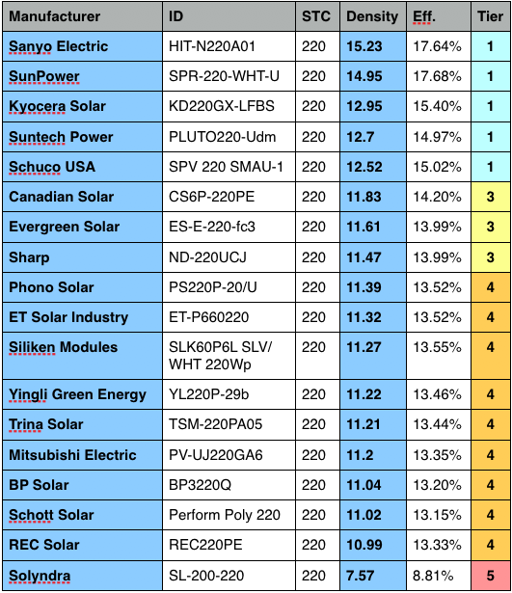
Reduce CO2 Using Renewable Energy

Slide 8
Reduce CO2 Using Renewable Energy
Wind Turbines
Wind Turbines.
Hawt
Horizontal-axis wind turbines (HAWT) have the main rotor shaft and electrical generator at the top of a tower, and may be pointed into or out of the wind.
Energy Range 100w – 10mw
Wind Class 1-7
Industrial Class wind turbines Cut in 3m/s
Industrial Class wind turbines Rated 10-13m/s
Industrial Class wind turbine Cut Out 20-25m/s
Rotor Diameter between 3m – 136m
Tower Size from between 6m – 143m
Swept Area as a guide 3 Time rotor diameter.

Slide 9
Reduce CO2 Using Renewable Energy
Wind Turbines
Wind Turbines.
Vawt
Vertical-axis wind turbines (VAWT) have the main rotor shaft vertical and electrical generator at the bottom.
Energy Range 100w – 10kw
Wind Class 1-7
Industrial Class wind turbines Cut in 2m/s
Industrial Class wind turbines Rated 9-12m/s
Industrial Class wind turbine Cut Out 30+m/s
Rotor Diameter between 3m – 6m
Swept Area as a guide 2 Time rotor diameter.

Slide 10
Reduce CO2 Using Renewable Energy
Wind Turbines Nacelle Type
Synchronised.
No Energy Required on Start up
Asynchronous.
Energy Required from the grid on Start up.
Transmission Type.
Direct Drive
Gearbox

Slide 11
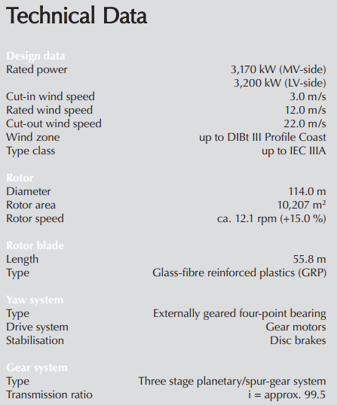
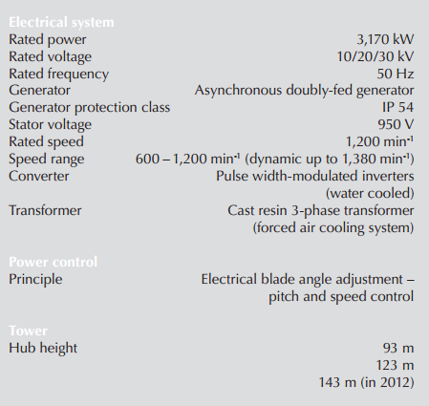
Reduce CO2 Using Renewable Energy
Typical Wind Turbine Specification

Slide 12
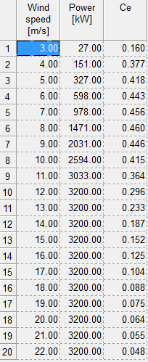
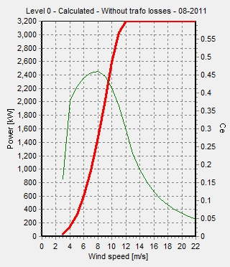
Reduce CO2 Using Renewable Energy
Typical Wind Turbine Specification

Slide 13
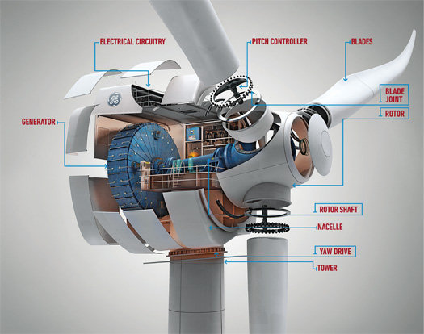
New Generation Wind Turbines
Increased Capture of wind resource.
3m/s Cut in speed
Increase Tower Size up to 143m onshore
Increase Rotor Size up to 128m onshore
More Efficient Direct Drive Mechanism, Eliminated Gears.
Increased wind Farm Annual Yield.
Less Turbines required to produce the same yield
Financial Implications.
Less Cover space.
Less Construction Cost.
Increased Availability Time.
Reduced Maintenance Cost.
Reduced Operational Cost.

Slide 14
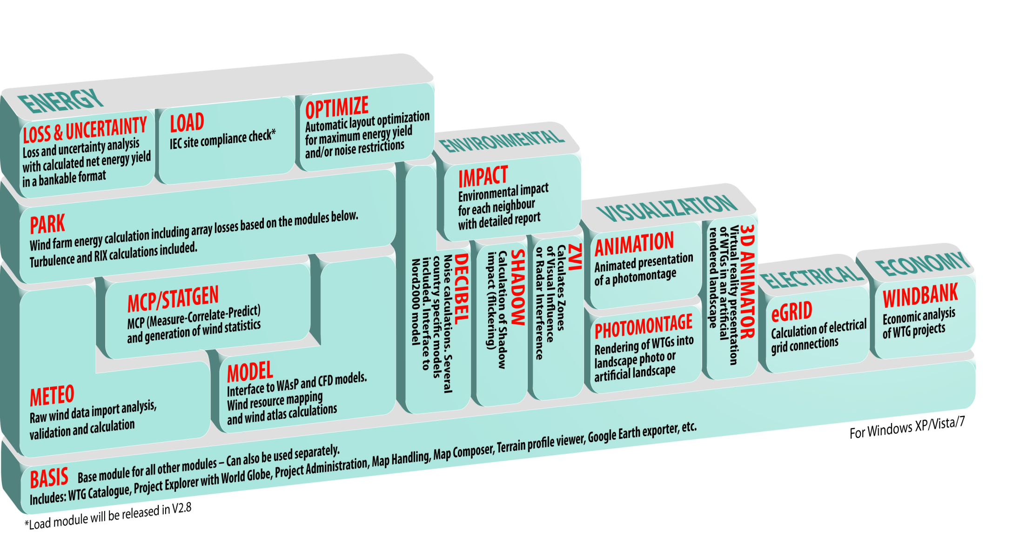
Desktop Software
EMD Wind Pro

Slide 15
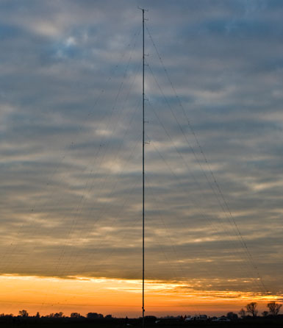
How did we Measure Wind
70m High Mast Nexgen
Sensors Placed 53m and 70m
Sensors
Vector A100LK Anemometer
Vector W200P Potentiometer Wind Vane
Setra Pressure Sensor Kit
Thermistor
Nomad 2 GSM Data logger

Slide 16
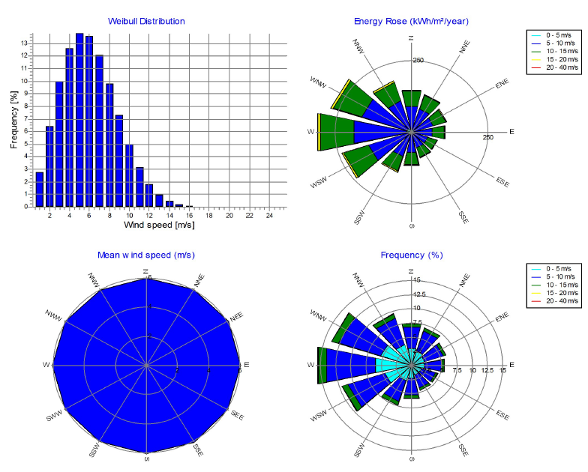
EMD Wasp Wind Analyses Mast Data
Weibull Distribution
Occurrence of wind speed in (%)
Energy Rose
Wind Direction and Occurrence
show KWh
Mean wind speed(m/s)
Average wind Distribution
Frequency(%)
Occurrence of wind speed against
Direction
Conclusion
53m wind reading 5.53-6.23m/s
70m wind reading 6.04-6.82m/s
Direction WNW-SSW

Slide 17
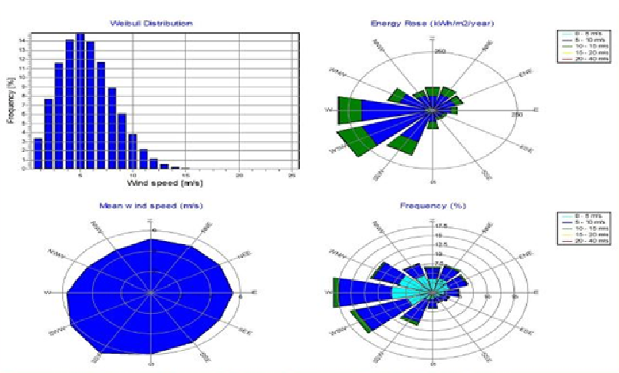
EMD Wasp Wind Analyses 30 years Satellite Data
Weibull Distribution
Occurrence of wind speed in (%)
Energy Rose
Wind Direction and Occurrence
show KWh
Mean wind speed(m/s)
Average wind Distribution
Frequency(%)
Occurrence of wind speed against
Direction
Conclusion
5.6 - 6.13m/s
Direction W-SSW

Slide 18
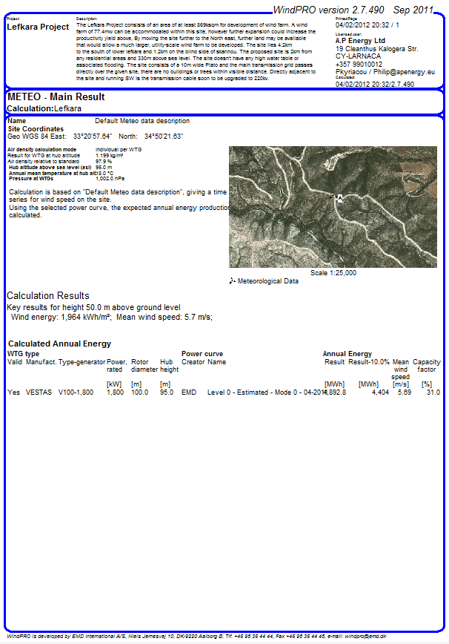
Wind Farm Main Results at 70m
Wind Speed
5.7m/s
Energy Produced per Turbine
4,892.8mw
Annual Yield
At 43 Turbines 1.8mw
210,390.4mw
Capacity Factor
31%

Slide 19
Legal Obligations
Cyprus Electricity Authority (EAC) Are Obliged to purchase all renewable energy produced.
EU Law: Brussels, 02.07.2009 C(2009)5398, N 143/2009 – Cyprus
“14. EAC will be obliged to buy all electricity produced in Cyprus from renewable sources and will carry out all administrative work related to the scheme, including the collection of the levy and the distribution of compensatory benefits to local authorities.”
Current Purchase Price per KW is 14.5c

Slide 20
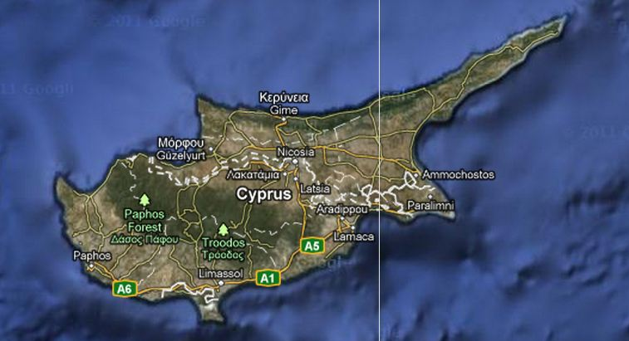
Renewable Energy Status in Cyprus
Current Annual Electricity Needs: 1.2 GW/h
By 2016 the Annual Electricity Needs: 1.6 GW/h
EU Directive to Produce 20% (13%) of the Needed Energy via Renewable Energy by 2020: 500 MW/h
Currently Licences Issued Cover 166MW/H
Current Annual Yield Produced via Renewable Energy is: <1%

Slide 21
Financial Overview
Project Plan
Project Construction Cost.
Operational Expenses.
Operational Income Impact.
Operational Income Overview.
Financial Summary.

Slide 22
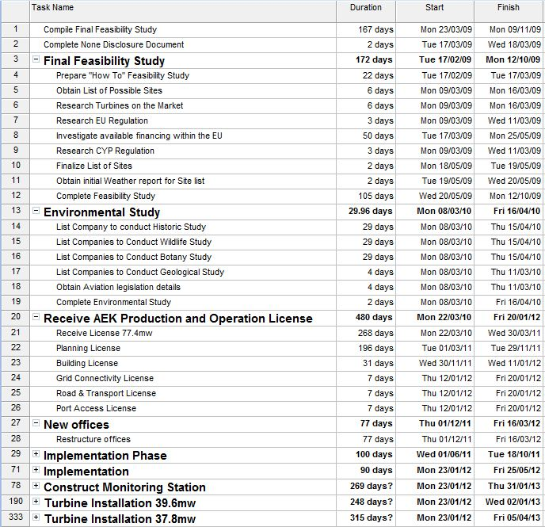
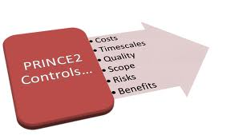
Summarised Project Plan (Prince 2)

Slide 23
Project Construction Costs
Turbines | € 77,400,000
Infrastructure | 4,578,000
80MVA Transformers | 4,000,000
3.5MVA Transformers | 6,400,000
Land Purchase | 10,000,000
Consultancy | 192,000
Civil Engineer | 2,392,000
Electrical Engineer | 450,000
Architect | 500,000
Buildings Concrete Foundations | 240,000
Steel | 640,000
Wind Turbine Foundations | 960,000
Crane Rental | 600,000
Site Security | 65,000
Buildings | 450,000
Control Systems | 2,100,000
Precast Conduit | 360,000
Cabling Electrical Network | 990,000
Cabling Data Network | 80,000
Miscellaneous | 850,000
Total Construction Expenses | € 113,247,000

Slide 24
Operational Expenses
 | 1st Year | 30th Year
Salary (Office & Overhead) | € 396,000 | € 534,550
Salary (Consultancy) | € 196,000 | € 250,000
Payroll (Social Security) | € 19,600 | € 33,455
Outside Services Security | € 40,000 | € 40,000
Supplies (Off and Operation) | € 30,000 | € 30,000
Repairs/ Maintenance | € 350,000 | € 3,105,034
Car, Delivery and Travel | € 4,000 | € 4,000
Accounting and Legal | € 20,000 | € 20,000
Telephone | € 3,600 | € 3,600
Utilities | € 18,000 | € 18,000
Insurance | € 1,543,450 | € 2,019,155
Land Rental | € 7,600 | € 7,600
Total Expenses | € 2,628,250 | € 6,065,393

Slide 25
Operational Income Impact
Global Retail Fuel Index's 2007-2011
Global Inflation Rate Index 1971-2011
Domestic Electricity Price Increase 12.9% between 2010-2011
Domestic Electricity Price Increase 29.2% between 2007-2011
Domestic Electricity Annual Average Price Increase 7.3% between 2007-2011
Cyprus Domestic Electricity Annual Average Price Increase 10.33% between 2009-2011
Income Impact at a Conservative 0%, 2% & 3.05% increase Annually?

Slide 26
Inflation and Fuel Index Increase

Slide 27
Operational Income Impact
Income Impact at a Conservative 0%, 2% & 3.05% increase of the Price of KW Annually for 30 Years
Current Price of KW: 14.5 c
Based on a Average Wind Speed Constant at: 5.7 m/s
Excluding any adjustment due to altitude from 70m-120m

Slide 28
Financial Summary
Operational Income comparison
 |  | Annual KW Price Increase of 0% | Annual KW Price Increase of 2% | Annual KW Price Increase of 3.05%
IRR (Internal Rate Of Return)
Gross |  | 20.90% | 23.25% | 24.45%
Net |  | 13.84% | 16.45% | 17.77%
NPV (Net Present Value)
6% |  | € 141,293,984 | € 243,071,316 | € 294,592,045
8% |  | € 141,293,984 | € 148,428,466 | € 206,795,197
10% |  | € 69,060,493 | € 120,492,149 | € 146,019,123
12% |  | € 47,345,893 | € 84,217,319 | € 102,865,684
PBP (Pay Back Period) |  | 6 Years 10 Months | 6 Years 8 Months | 6 Years 7 Months
Sales Balance (30 years) |  | € 738,300,411 | € 1,090,628,160 | € 1,295,334,289

Slide 29
Income Comparison Overview
Duration - Years

Slide 30
Operational Income Margins
Thank You For Attending Any Questions?

